Slide 1
Embedded Systems Introduction
Introduction to Arduino
Eng. Giacomo Silvagni, Ph.D.
Alma Mater Studiorum – University of Bologna
Department of Industrial Engineering (DIN)

Slide 2
Outline
Arduino
Arduino Programming Language (IDE)
Examples
Arduino & Matlab
Arduino & Simulink
Arduino & Python

Slide 3
Outline
Arduino
Arduino Programming Language (IDE)
Examples
Arduino & Matlab
Arduino & Simulink
Arduino & Python

Slide 4
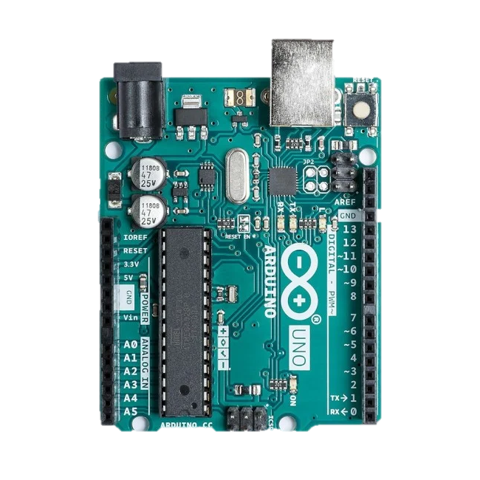
Introduction to Arduino
Arduino

Slide 5
Introduction to Arduino
Arduino
Advantages
It does not require additional hardware to be programmed
Disadvantages
Limited computational capacity
Limited number of interrupt pin: 2
Limited number of sensors that can be connected

Slide 6
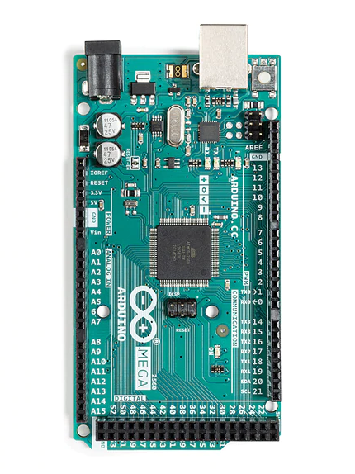
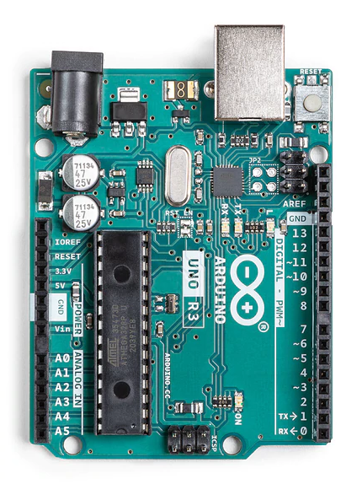
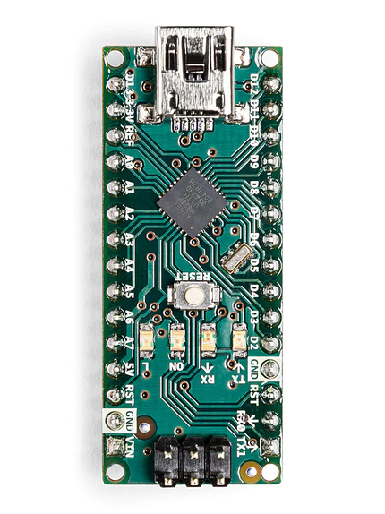
Introduction to Arduino
Arduino
MEGA
UNO
NANO

Slide 7
Introduction to Arduino
Arduino
MICROCONTROLLER | ATmega328
ARCHITECTURE | AVR
OPERATING VOLTAGE | 5 V
FLASH MEMORY | 32 KB of which 2 KB used by bootloader
SRAM | 2 KB
CLOCK SPEED | 16 MHz
ANALOG IN PINS | 8
EEPROM | 1 KB
DC CURRENT PER I/O PINS | 40 mA (I/O Pins)
INPUT VOLTAGE | 7-12V
DIGITAL I/O PINS | 22 (6 of which are PWM)
PWM OUTPUT | 6
POWER CONSUMPTION | 19 mA
PCB SIZE | 18 x 45 mm
WEIGHT | 7 g
PRODUCT CODE | A000005
NANO

Slide 8
Introduction to Arduino
Arduino
UNO
MICROCONTROLLER | ATmega328P
OPERATING VOLTAGE | 5V
INPUT VOLTAGE (RECOMMENDED) | 7-12V
INPUT VOLTAGE (LIMIT) | 6-20V
DIGITAL I/O PINS | 14 (of which 6 provide PWM output)
PWM DIGITAL I/O PINS | 6
ANALOG INPUT PINS | 6
DC CURRENT PER I/O PIN | 20 mA
DC CURRENT FOR 3.3V PIN | 50 mA
FLASH MEMORY | 32 KB (ATmega328P) of which 0.5 KB used by bootloader
SRAM | 2 KB (ATmega328P)
EEPROM | 1 KB (ATmega328P)
CLOCK SPEED | 16 MHz
LED_BUILTIN | 13
LENGTH | 68.6 mm
WIDTH | 53.4 mm
WEIGHT | 25 g

Slide 9
Introduction to Arduino
Arduino
MEGA
MICROCONTROLLER | ATmega2560
OPERATING VOLTAGE | 5V
INPUT VOLTAGE (RECOMMENDED) | 7-12V
INPUT VOLTAGE (LIMIT) | 6-20V
DIGITAL I/O PINS | 54 (of which 15 provide PWM output)
ANALOG INPUT PINS | 16
DC CURRENT PER I/O PIN | 20 mA
DC CURRENT FOR 3.3V PIN | 50 mA
FLASH MEMORY | 256 KB of which 8 KB used by bootloader
SRAM | 8 KB
EEPROM | 4 KB
CLOCK SPEED | 16 MHz
LED_BUILTIN | 13
LENGTH | 101.52 mm
WIDTH | 53.3 mm
WEIGHT | 37 g

Slide 10
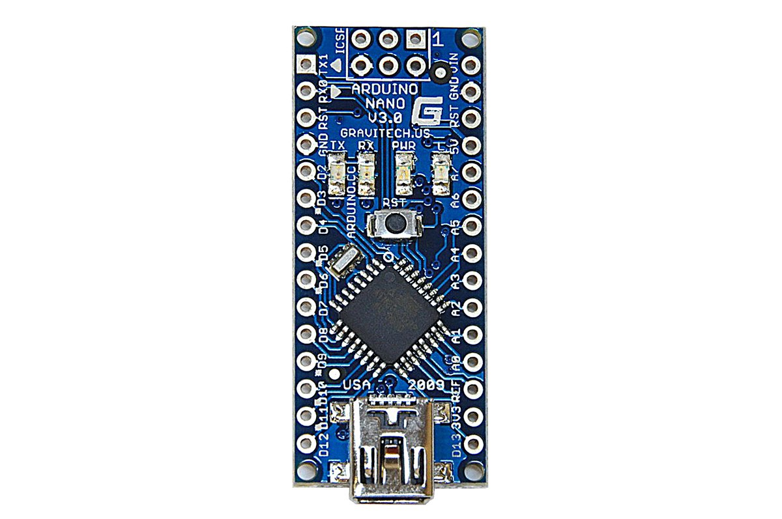
Introduction to Arduino
Arduino
NANO
3.3V Output (limited to 25mA)
Digital Pin 14/Analog Pin 0
Digital Pin 15/Analog Pin 1
Digital Pin 16/Analog Pin 2
Digital Pin 17/Analog Pin 3
Digital Pin 18/(I2C) SDA/Analog Pin 4
Digital Pin 19/(I2C) SCL/Analog Pin 5
Analog Pin 6
Analog Pin 7
5V Output or Input
GND
7-12V Power Input
PWM/Digital Pin 9
Digital Pin 8
Digital Pin 7
PWM/Digital Pin 6
PWM/Digital Pin 5
Digital Pin 4
Ext Int 1/Digital Pin 3
Ext Int 0/Digital Pin 2
GND

Slide 11
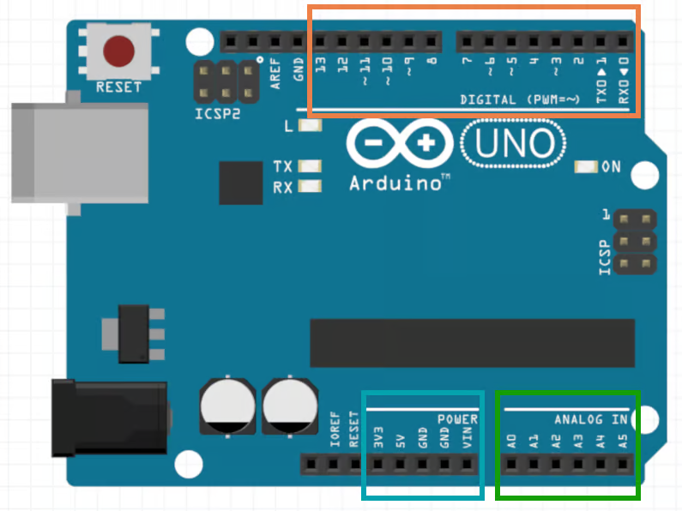
Introduction to Arduino
Arduino
UNO
Orange rectangle: These are 13 digital pins that you can use as inputs or outputs. They’re only meant to work with digital signals, which have 2 different levels:
Level 0: represented by the voltage 0V
Level 1: represented by the voltage 5V
Green rectangle: These are 6 analog pins that you can use as analog inputs. They’re meant to work with an arbitrary voltage between 0V and 5V.
Blue rectangle: These are 5 power pins. They’re mainly used for powering external components.

Slide 12
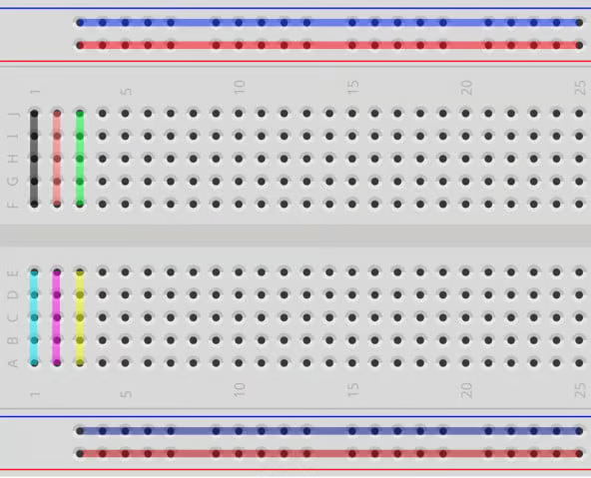
Introduction to Arduino
Arduino
Electronic circuit projects usually involve testing several ideas, with you adding new components and making adjustments as you go. However, it can be tricky to connect components directly, especially if the circuit is large.
To facilitate prototyping, you can use a breadboard to connect the components. This is a device with several holes that are connected in a particular way so that you can easily connect components using jumper wires:
You can see which holes are interconnected by looking at the colored lines. You’ll use the holes on the sides of the breadboard to power the circuit:
Connect one hole on the red line to the power source.
Connect one hole on the blue line to the ground.

Slide 13
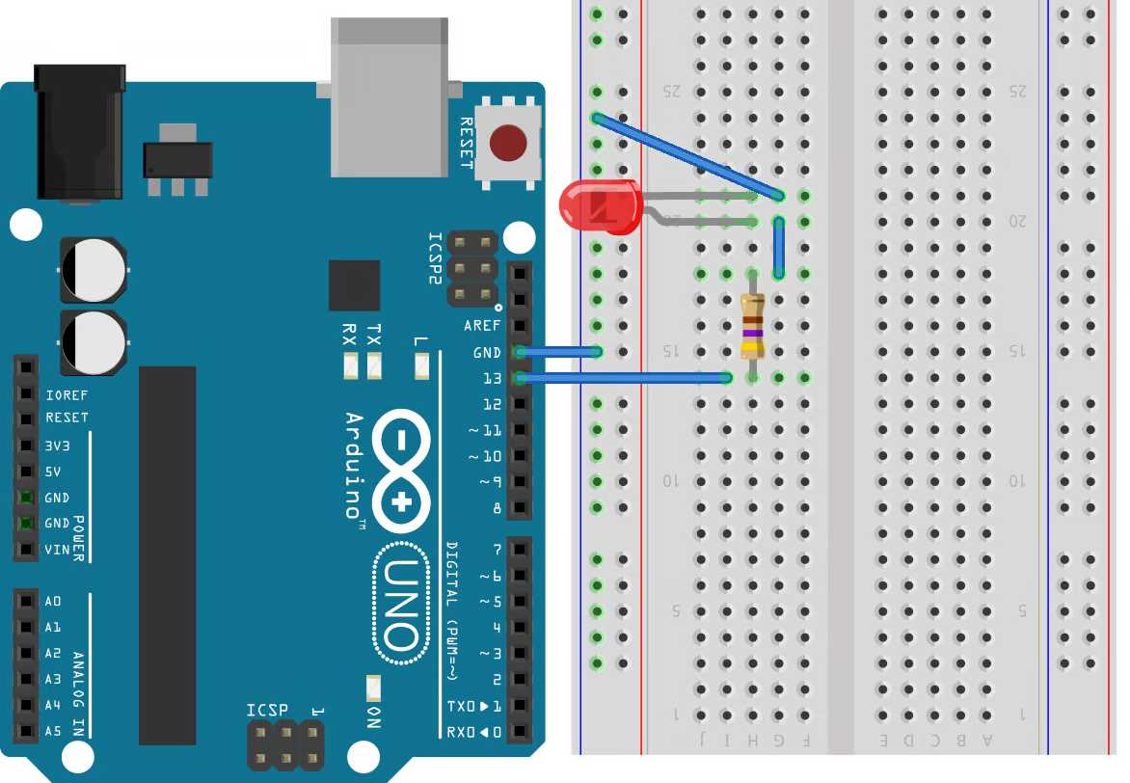
Introduction to Arduino
Arduino
Then, you can easily connect components to the power source or the ground by simply using the other holes on the red and blue lines. The holes in the middle of the breadboard are connected as indicated by the colors. You’ll use these to make connections between the components of the circuit. These two internal sections are separated by a small depression, over which you can connect integrated circuits (ICs).

Slide 14
Outline
Arduino
Arduino Programming Language (IDE)
Examples
Arduino & Matlab
Arduino & Simulink
Arduino & Python

Slide 15
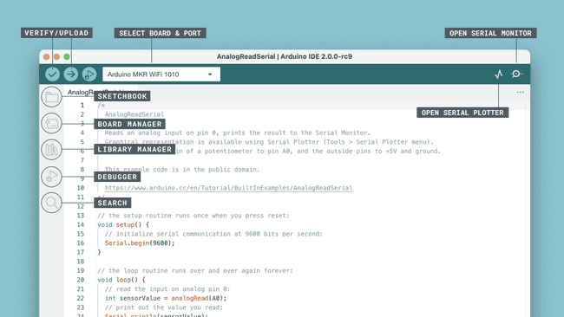
Introduction to Arduino
Arduino Programming IDE
The Arduino API, aka the "Arduino Programming Language", consists of several functions, variables and structures based on the C/C++ language.

Slide 16
Introduction to Arduino
Arduino Programming IDE
Main Parts
The Arduino API can be divided into three main parts: functions, variables and structure:
Functions: for controlling the Arduino board and performing computations. For example, to read or write a state to a digital pin, map a value or use serial communication.
Variables: the Arduino constants, data types and conversions. E.g. int, boolean, array.
Structure: the elements of the Arduino (C++) code, such as
sketch (loop(), setup())
control structure (if, else, while, for)
arithmetic operators (multiplication, addition, subtraction)
comparison operators, such as == (equal to), != (not equal to), > (greater than).
The Arduino API can be described as a simplification of the C++ programming language, with a lot of additions for controlling the Arduino hardware.

Slide 17
Introduction to Arduino
Arduino Programming IDE
Program Structure
The absolute minimum requirement of an Arduino program is the use of two functions: void setup() and void loop().
The "void" indicates that nothing is returned on execution.
void setup() - this function executes only once, when the Arduino is powered on. Here we define things such as the mode of a pin (input or output), the baud rate of serial communication or the initialization of a library.
void loop() - this is where we write the code that we want to execute over and over again, such as turning on/off a lamp based on an input, or to conduct a sensor reading every X second.
The above functions are always required in an Arduino sketch, but you are of course able to add several more functions, which is useful for longer programs.

Slide 18
Introduction to Arduino
Arduino Programming IDE
The «Sketch»
In the Arduino project, a program is referred to as a "sketch".
A sketch is a file that you write your program inside. It has the .ino extension, and is always stored in a folder of the same name.
The folder can include other files, such as a header file, that can be included in your sketch.

Slide 19
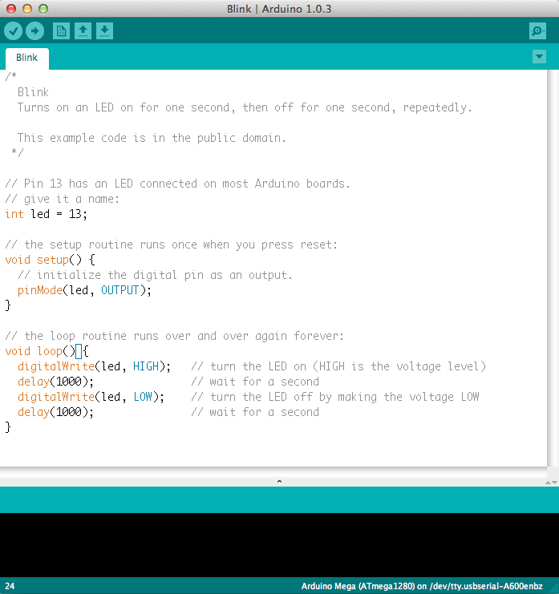
Introduction to Arduino
Arduino Programming IDE
Example

Slide 20
Introduction to Arduino
Arduino Programming IDE
You can find the full list of available resources and actions in the Arduino Cloud Application API Technical Reference.
https://www.arduino.cc/reference/en/iot/api/
https://github.com/arduino/arduino-examples
https://docs.arduino.cc/built-in-examples/

Slide 21
Outline
Arduino
Arduino Programming Language (IDE)
Examples
Read Analog Voltage
Digital Read Serial
Blink without Delay
Sensors
Arduino & Matlab
Arduino & Simulink
Arduino & Python

Slide 22
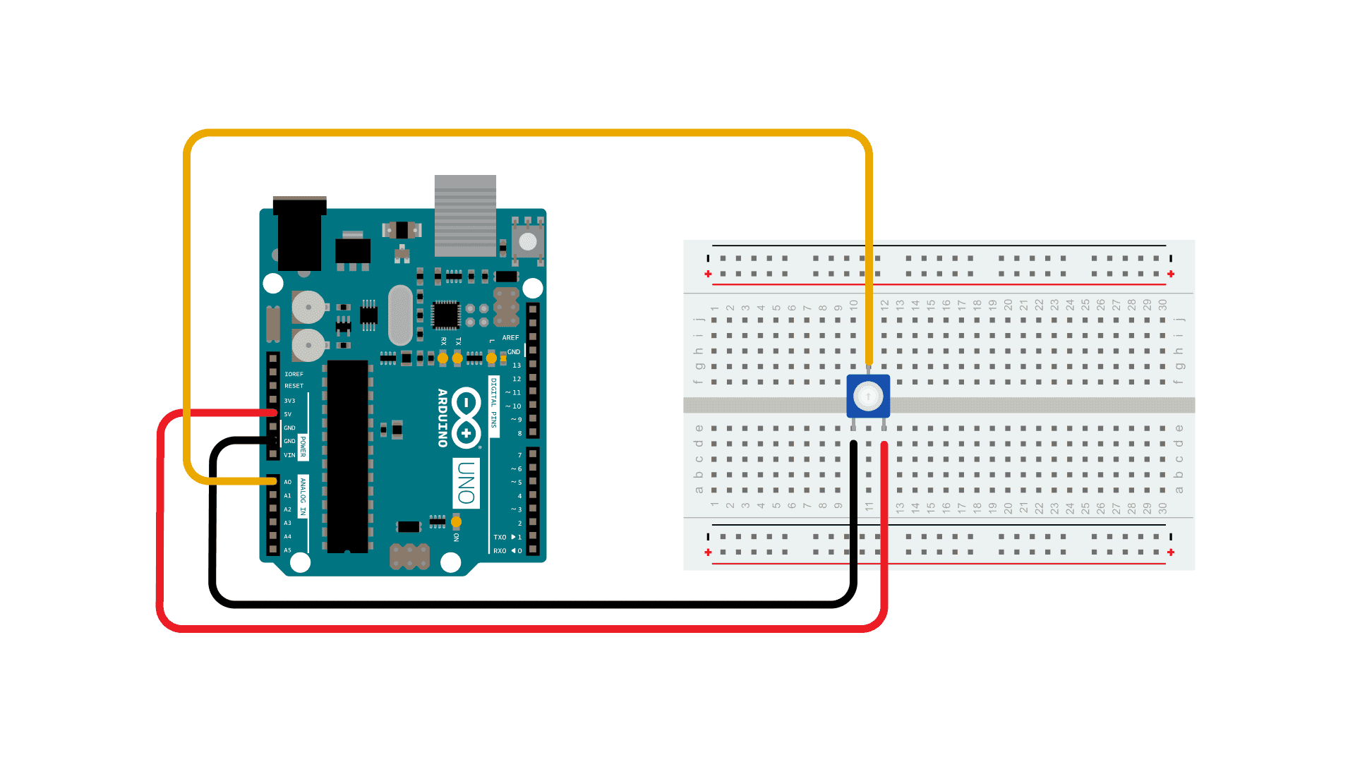
Introduction to Arduino
Examples – Read Analog Voltage
Aim: This example shows you how to read an analog input on analog pin 0, convert the values from analogRead() into voltage, and print it out to the serial monitor of the Arduino Software (IDE).
Hardware required:
Arduino Board
10kΩ potentiometer
Resource: https://docs.arduino.cc/built-in-examples/basics/ReadAnalogVoltage/

Slide 23
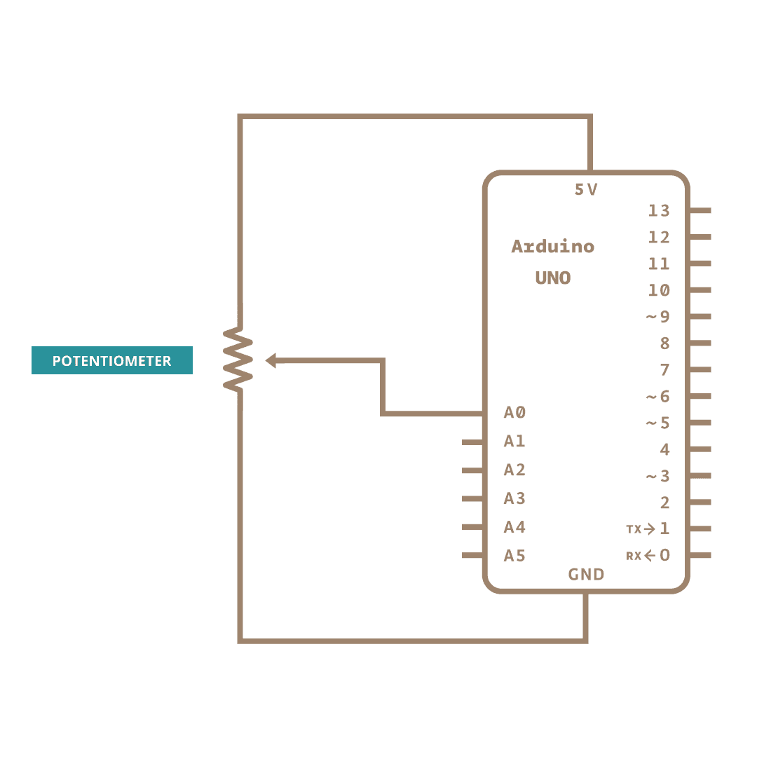
Introduction to Arduino
Examples – Read Analog Voltage
Connect the three wires from the potentiometer to your board. The first goes to ground from one of the outer pins of the potentiometer. The second goes to 5 volts from the other outer pin of the potentiometer. The third goes from the middle pin of the potentiometer to analog input 0.
Resource: https://docs.arduino.cc/built-in-examples/basics/ReadAnalogVoltage/

Slide 24
Introduction to Arduino
Examples – Read Analog Voltage
By turning the shaft of the potentiometer, you change the amount of resistance on either side of the wiper which is connected to the center pin of the potentiometer. This changes the voltage at the center pin. When the resistance between the center and the side connected to 5 volts is close to zero (and the resistance on the other side is close to 10 kilohms), the voltage at the center pin nears 5 volts. When the resistances are reversed, the voltage at the center pin nears 0 volts, or ground. This voltage is the analog voltage that you're reading as an input.
Resource: https://docs.arduino.cc/built-in-examples/basics/ReadAnalogVoltage/

Slide 25
Introduction to Arduino
Examples – Read Analog Voltage
In the program below:
You'll do will be in the setup function, to begin serial communication at 9600 bits of data per second
In the main loop of your code, you need to establish a variable to store the resistance value (which will be between 0 and 1023, perfect for an intdatatype) coming in from your potentiometer
To change the values from 0-1023 to a range that corresponds to the voltage the pin is reading, you'll need to create another variable, a float, and do a little math. To scale the numbers between 0.0 and 5.0, divide 5.0 by 1023.0 and multiply that by sensorValue
You need to print this information to your serial monitor.
Outcome:
Now, when you open your Serial Monitor in the Arduino IDE (by clicking on the icon on the right side of the top green bar or pressing Ctrl+Shift+M), you should see a steady stream of numbers ranging from 0.0 - 5.0. As you turn the pot, the values will change, corresponding to the voltage coming into pin A0
Resource: https://docs.arduino.cc/built-in-examples/basics/ReadAnalogVoltage/

Slide 26
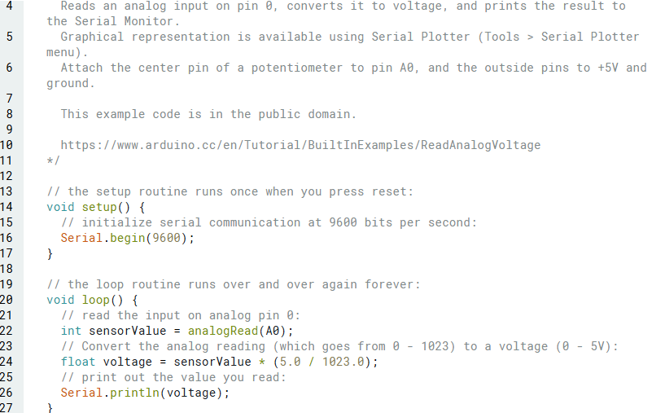
Introduction to Arduino
Examples – Read Analog Voltage
Code
Resource: https://docs.arduino.cc/built-in-examples/basics/ReadAnalogVoltage/

Slide 27
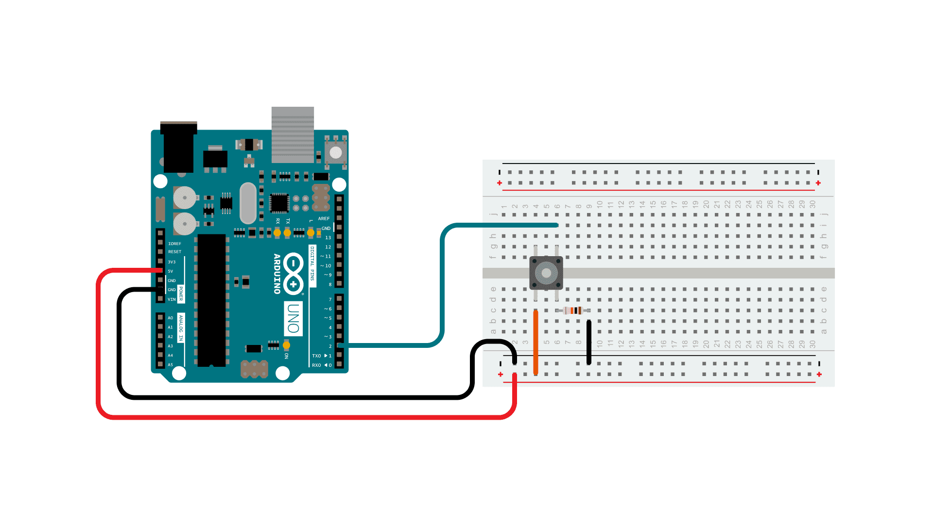
Introduction to Arduino
Examples – Digital Read Serial
Aim: This example shows you how to monitor the state of a switch by establishing serial communication between your Arduino and your computer over USB.
Hardware required:
Arduino Board
Momentary switch, button, or toggle switch
10kΩ resistor
Resource: https://docs.arduino.cc/built-in-examples/

Slide 28
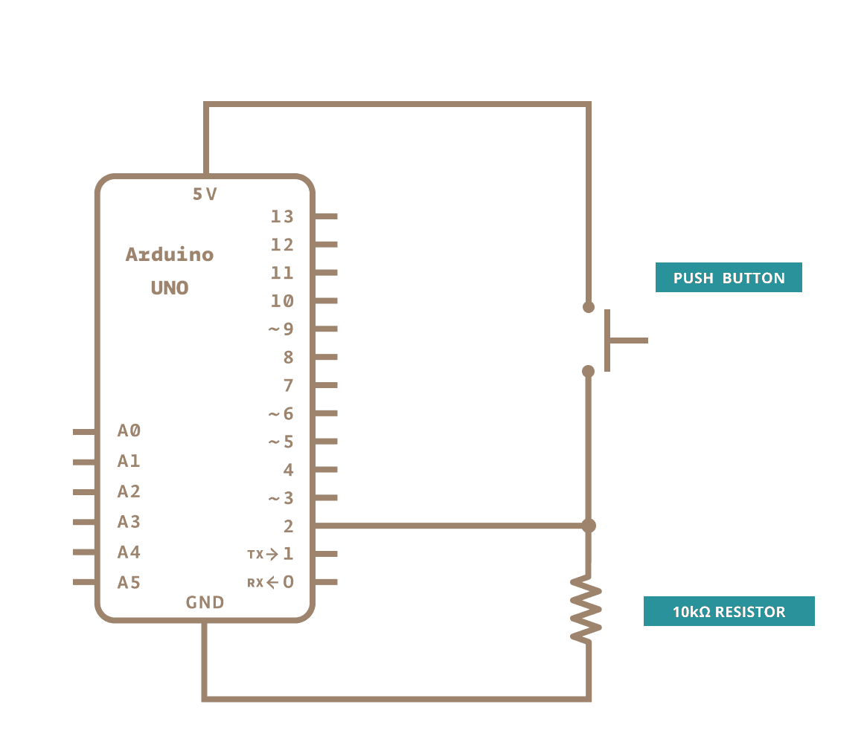
Introduction to Arduino
Examples – Digital Read Serial
Connect three wires to the board. The first two, red and black, connect to the two long vertical rows on the side of the breadboard to provide access to the 5 volt supply and ground. The third wire goes from digital pin 2 to one leg of the pushbutton. That same leg of the button connects through a pull-down resistor (here 10k ohm) to ground. The other leg of the button connects to the 5 volt supply.
Resource: https://docs.arduino.cc/built-in-examples/

Slide 29
Introduction to Arduino
Examples – Digital Read Serial
Pushbuttons or switches connect two points in a circuit when you press them. When the pushbutton is open (unpressed) there is no connection between the two legs of the pushbutton, so the pin is connected to ground (through the pull-down resistor) and reads as LOW, or 0. When the button is closed (pressed), it makes a connection between its two legs, connecting the pin to 5 volts, so that the pin reads as HIGH, or 1.
Resource: https://docs.arduino.cc/built-in-examples/

Slide 30
Introduction to Arduino
Examples – Digital Read Serial
If you disconnect the digital i/o pin from everything, its reading may change erratically. This is because the input is "floating" - that is, it doesn't have a solid connection to voltage or ground, and it will randomly return either HIGH or LOW. That's why you need a pull-down resistor in the circuit.
Resource: https://docs.arduino.cc/built-in-examples/

Slide 31
Introduction to Arduino
Examples – Digital Read Serial
In the program below:
You'll do will be in the setup function, to begin serial communication at 9600 bits of data per second
Initialize digital pin 2, the pin that will read the output from your button, as an input:
Move into the main loop of your code. When your button is pressed, 5 volts will freely flow through your circuit, and when it is not pressed, the input pin will be connected to ground through the 10k ohm resistor. This is a digital input, meaning that the switch can only be in either an on state (seen by your Arduino as a "1", or HIGH) or an off state (seen by your Arduino as a "0", or LOW), with nothing in between.
In the main loop of your program is to establish a variable to hold the information coming in from your switch. Since the information coming in from the switch will be either a "1" or a "0", you can use an intdatatype. Call this variable sensorValue, and set it to equal whatever is being read on digital pin 2.
make it print this information back to the computer as a decimal value. You can do this with the command Serial.println()
Resource: https://docs.arduino.cc/built-in-examples/

Slide 32
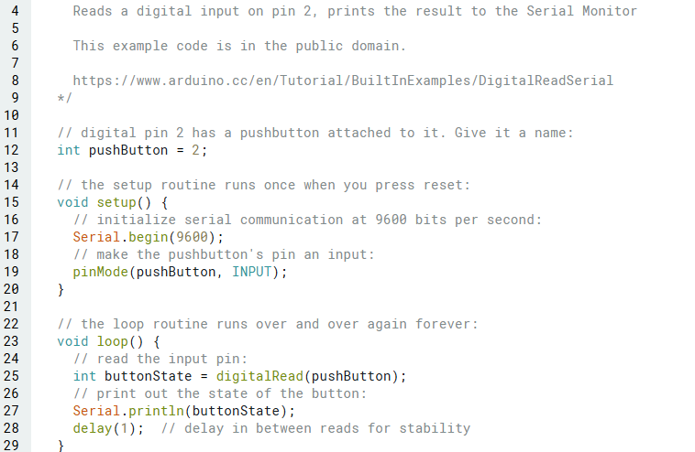
Introduction to Arduino
Examples – Digital Read Serial
Code
Resource: https://docs.arduino.cc/built-in-examples/

Slide 33
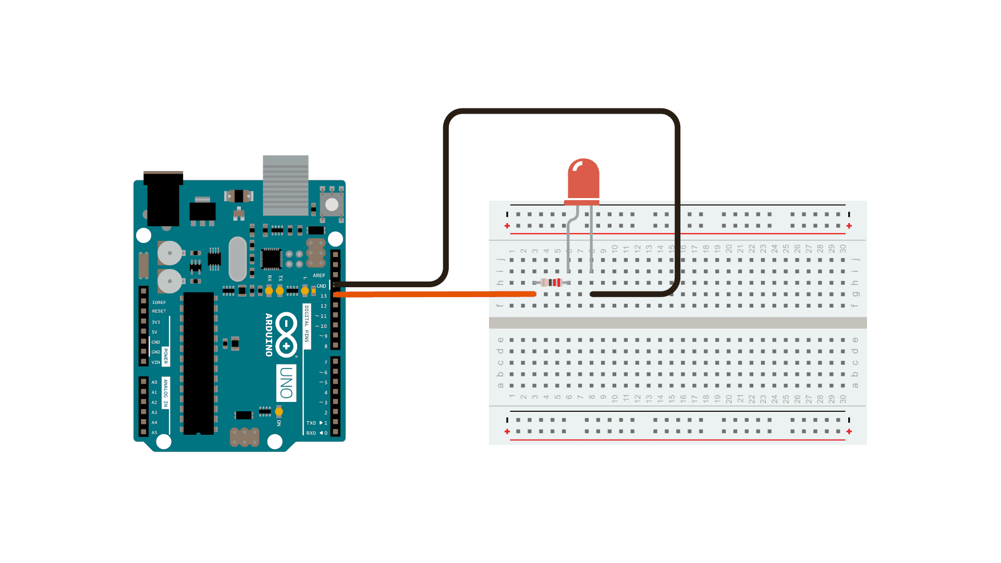
Introduction to Arduino
Examples – Blink without Delay
Aim: This sketch demonstrates how to blink an LED without using delay(). It turns the LED on and then makes note of the time. Then, each time through loop(), it checks to see if the desired blink time has passed. If it has, it toggles the LED on or off and makes note of the new time. In this way the LED blinks continuously while the sketch execution never lags on a single instruction.
Hardware required:
Arduino Board
LED
220Ω resistor
Resource: https://docs.arduino.cc/built-in-examples/

Slide 34
Introduction to Arduino
Examples – Blink without Delay
To build the circuit, connect one end of the resistor to pin 13 of the board. Connect the long leg of the LED (the positive leg, called the anode) to the other end of the resistor. Connect the short leg of the LED (the negative leg, called the cathode) to the board GND, as shown in the diagram above and the schematic below.
Most Arduino boards already have an LED attached to pin 13 on the board itself. If you run this example with no hardware attached, you should see that LED blink.
Resource: https://docs.arduino.cc/built-in-examples/

Slide 35
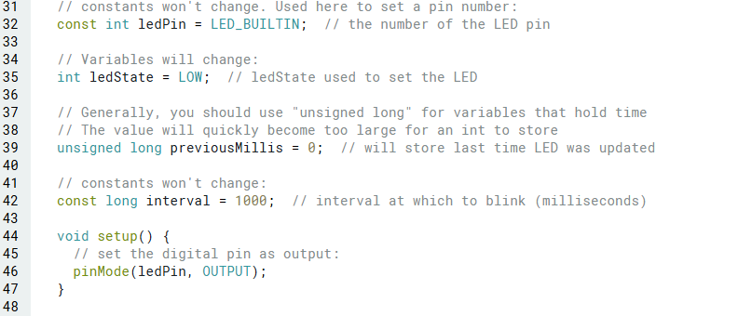
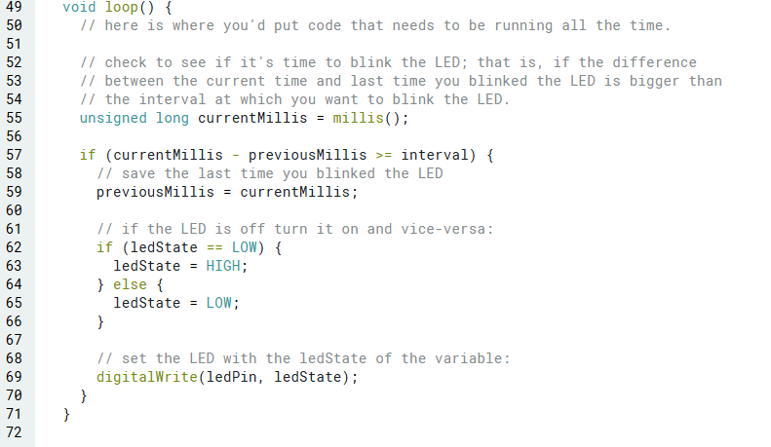
Introduction to Arduino
Examples – Blink without Delay
Code
SETUP
MAIN LOOP
Resource: https://docs.arduino.cc/built-in-examples/

Slide 36
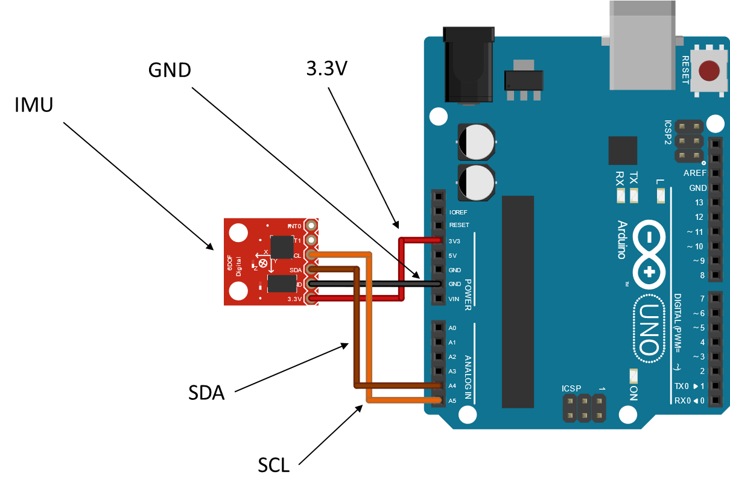
Introduction to Arduino
Examples – Sensors
Inertial Measurement Unit
GY-87 10DOF
Magnetometer - HMC5883L
Gyro + Accelerometer - MPU6050
Barometric pressure sensor - BMP180
Temperature sensor - BMP180
Resource: https://docs.arduino.cc/built-in-examples/

Slide 37
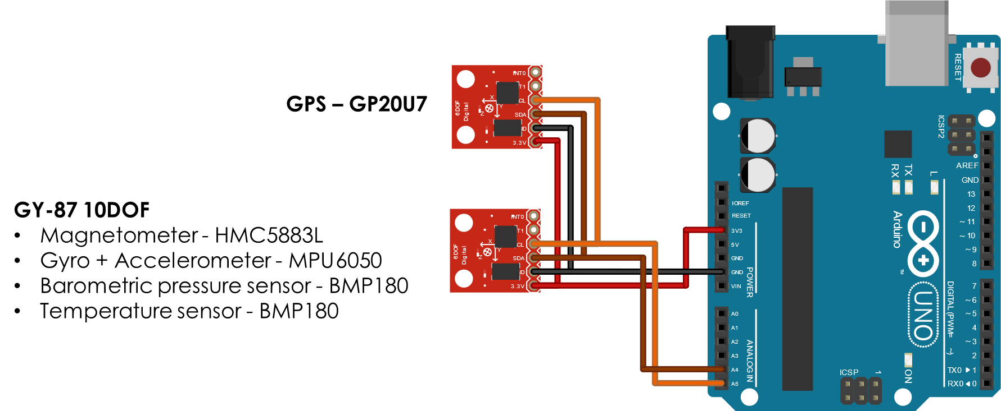
Introduction to Arduino
Examples – Sensors
Multiple sensors wirings
Resource: https://docs.arduino.cc/built-in-examples/

Slide 38
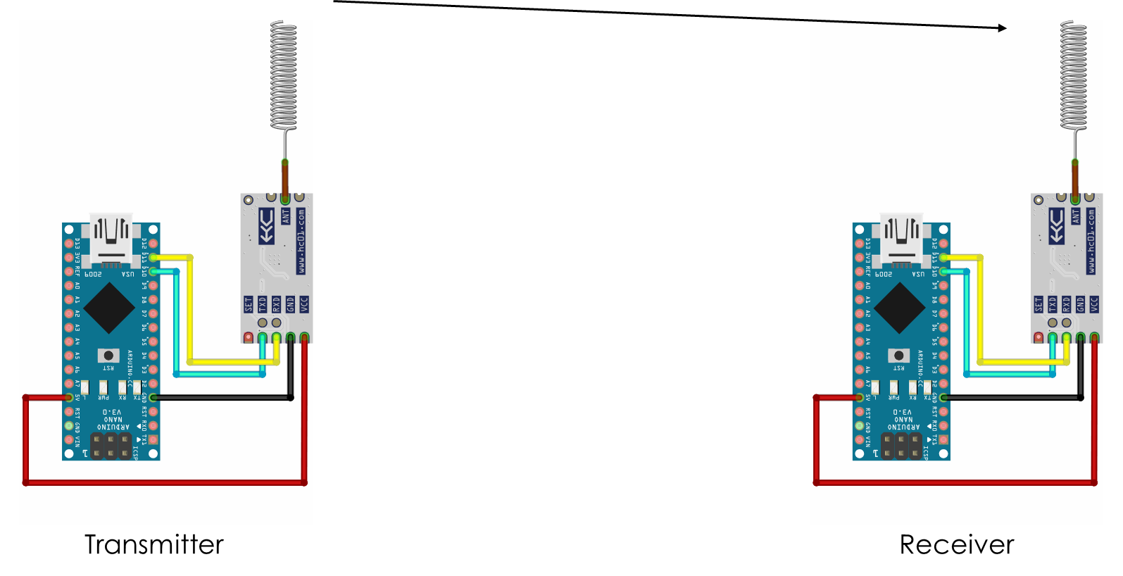
Introduction to Arduino
Examples – Sensors
Wireless communication
Resource: https://docs.arduino.cc/built-in-examples/

Slide 39
Outline
Arduino
Arduino Programming Language (IDE)
Examples
Arduino & Matlab
Arduino & Simulink
Arduino & Python

Slide 40
Introduction to Arduino
Arduino & Matlab
What is Matlab ?
Matlab or Matrix Laboratory is a high-level programming language consisting of an interactive environment mainly used for numeric computation, programming, and visualization.
What does Matlab can do ?
Dealing with Matrices and Arrays
2-D and 3-D Plotting and graphics
Linear Algebra
Algebraic Equations
Non-linear Functions
Statistics
Data Analysis
Calculus and Differential Equations
Numerical Calculations
Integration
Transforms
Curve Fitting
Various other special functions
……
Reference: https://www.mathworks.com

Slide 41
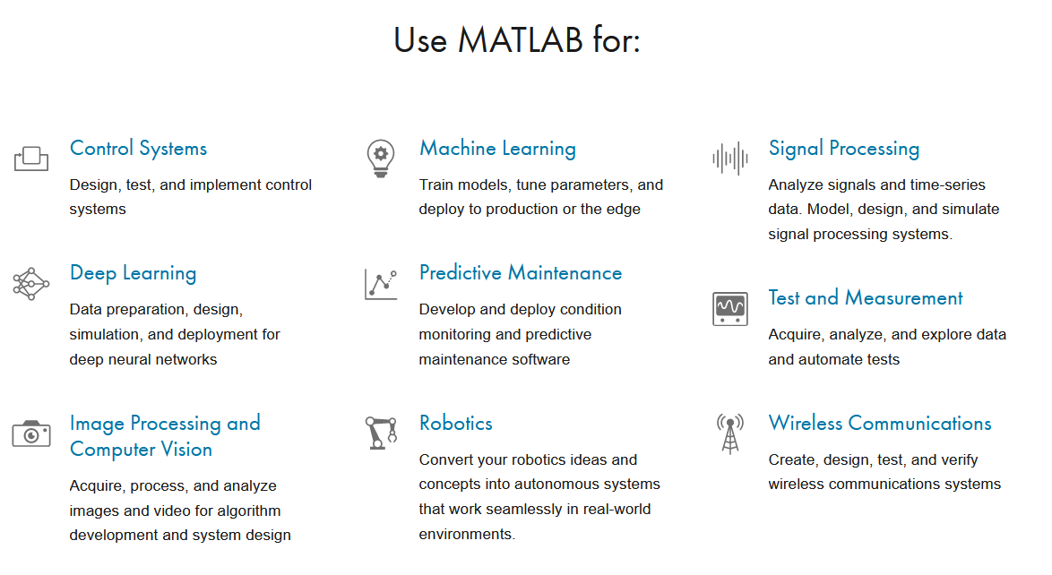
Introduction to Arduino
Arduino & Matlab
Where is Matlab ?
Website: https://www.mathworks.com
Why Matlab is important ?
High powerful tool
Improve your programming skills
Matlab skills appreciated by companies
Matlab connects theory knowledge to practice
Is Matlab available for students ?
ABSOLUTELY YES !!
Reference: https://www.mathworks.com

Slide 42
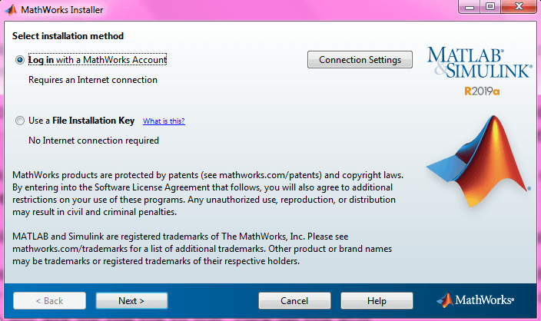
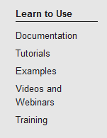
Introduction to Arduino
Arduino & Matlab
How can I get Matlab ?
Website: https://www.mathworks.com
Create your Mathworks account using your @studio.unibo.it credentials
Download the last .b Matlab Release (i.e. 2020b)
Select the add-ons (i.e. Simulink, Mathematical, Statistical, …)
Wait, activate your products and enjoy !
How can I learn Matlab ?
Reference: https://www.mathworks.com

Slide 43
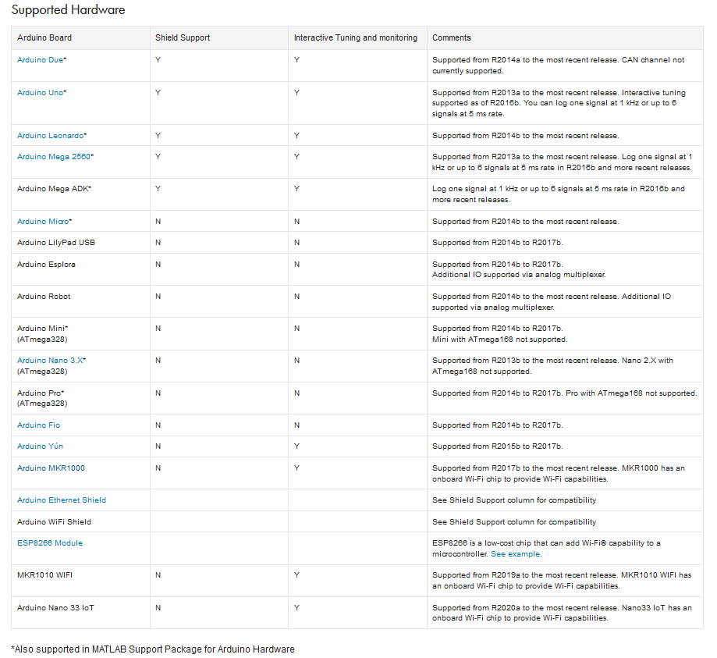
Introduction to Arduino
Arduino & Matlab
With MATLAB® Support Package for Arduino® Hardware, you can use MATLAB to interactively communicate with an Arduino board.
IF YOU WANT TO USE ARDUINO WITH MATLAB, YOU NEED TO DOWNLOAD AND INSTALL THE SUPPORT PACKAGE !
Watch the video: https://www.youtube.com/watch?v=8NQ1h0gGgX8
EXAMPLES AND DOCUMENTATIONS ON GITHUB
https://duinobasedlearning.github.io/P0_en.html
References: https://www.mathworks.com/hardware-support/arduino-matlab.html

Slide 44
Outline
Arduino
Arduino Programming Language (IDE)
Examples
Arduino & Matlab
Arduino & Simulink
Arduino & Python

Slide 45
Introduction to Arduino
Arduino & Simulink
What is Simulink ?
Engineers and scientists use Simulink® to perform multidomain modelling and simulation, because you can reuse models across environments to simulate how all parts of the system work together.
What Does Simulink can do ?
Model your system across domains using specific tools and prebuilt blocks.
Develop large-scale models through componentization with reusable system components and libraries.
Combine your models into one system-level simulation even if they weren’t built in Simulink.
Run massive simulations in parallel on your multicore desktop, computer cluster, or the cloud, without writing lots of code.
Share simulations as standalone executables, web apps…
Reference: https://www.mathworks.com/solutions/system-design-simulation.html

Slide 46
Introduction to Arduino
Arduino & Simulink
What is Simulink ?
Engineers and scientists use Simulink® to perform multidomain modelling and simulation, because you can reuse models across environments to simulate how all parts of the system work together.
What Does Simulink can do ?
Model your system across domains using specific tools and prebuilt blocks.
Develop large-scale models through componentization with reusable system components and libraries.
Combine your models into one system-level simulation even if they weren’t built in Simulink.
Run massive simulations in parallel on your multicore desktop, computer cluster, or the cloud, without writing lots of code.
Share simulations as standalone executables, web apps…
Reference: https://www.mathworks.com/solutions/system-design-simulation.html

Slide 47
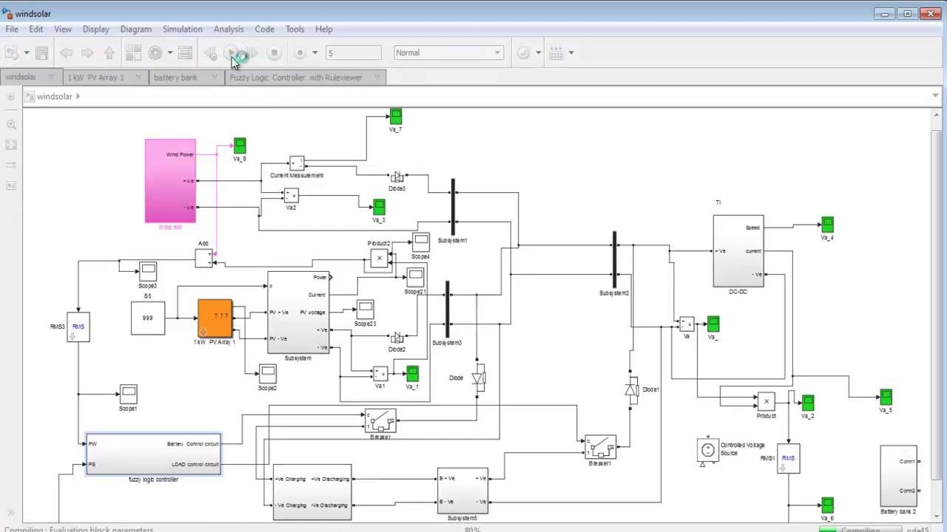
Introduction to Arduino
Arduino & Simulink
What is Simulink ?
Engineers and scientists use Simulink® to perform multidomain modelling and simulation, because you can reuse models across environments to simulate how all parts of the system work together.
What Does Simulink can do ?
Model your system across domains using specific tools and prebuilt blocks.
Develop large-scale models through componentization with reusable system components and libraries.
Combine your models into one system-level simulation even if they weren’t built in Simulink.
Run massive simulations in parallel on your multicore desktop, computer cluster, or the cloud, without writing lots of code.
Share simulations as standalone executables, web apps…
Reference: https://www.mathworks.com/solutions/system-design-simulation.html

Slide 48
Introduction to Arduino
Arduino & Simulink
Where is Simulink ?
Matlab add-on on your license
Why Simulink is so important ?
ENGINEERS AND SCIENTISTS WORLDWIDE RELY ON SIMULINK

Slide 49
Introduction to Arduino
Arduino & Simulink
Arduino® programming is supposed to be fun, but it can become frustrating and time consuming.
Simulink support developers in 2 primary workflows:
Read, write, and analyze data from Arduino sensors
Develop algorithms that run standalone on the Arduino device

Slide 50
Introduction to Arduino
Arduino & Simulink
With Simulink® Support Package for Arduino® Hardware, you can use Simulink to develop and simulate algorithms that run standalone on your Arduino.
IF YOU WANT TO USE ARDUINO SIMULINK, YOU NEED TO DOWNLOAD AND INSTALL THE SUPPORT PACKAGE !
Watch the video: https://www.youtube.com/watch?v=9ttIZoUXCKY
References: https://www.mathworks.com/hardware-support/arduino-simulink.html

Slide 51
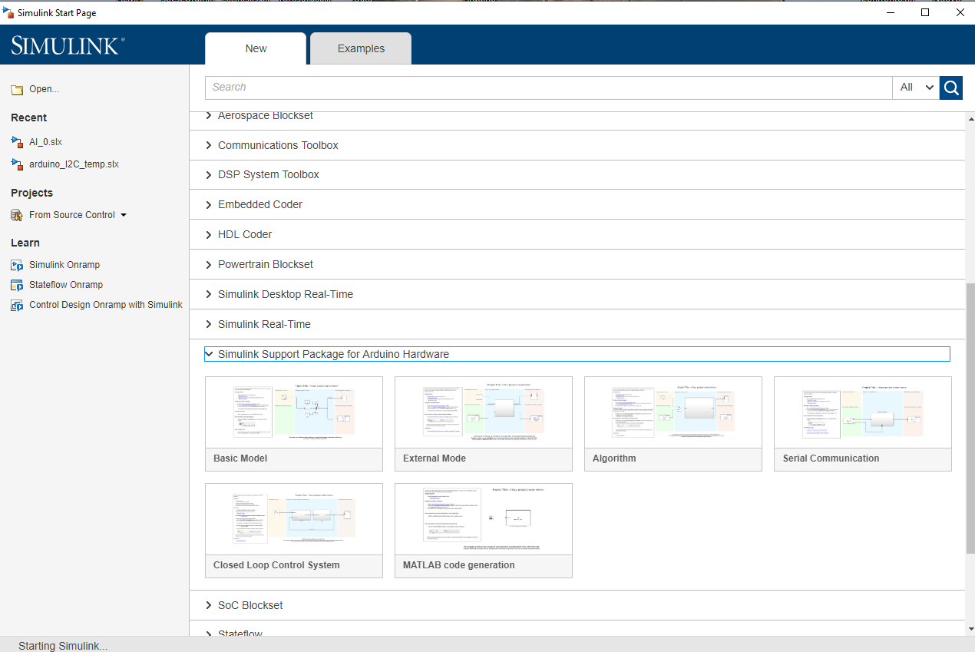
Introduction to Arduino
Arduino & Simulink
References: https://www.mathworks.com/hardware-support/arduino-simulink.html

Slide 52
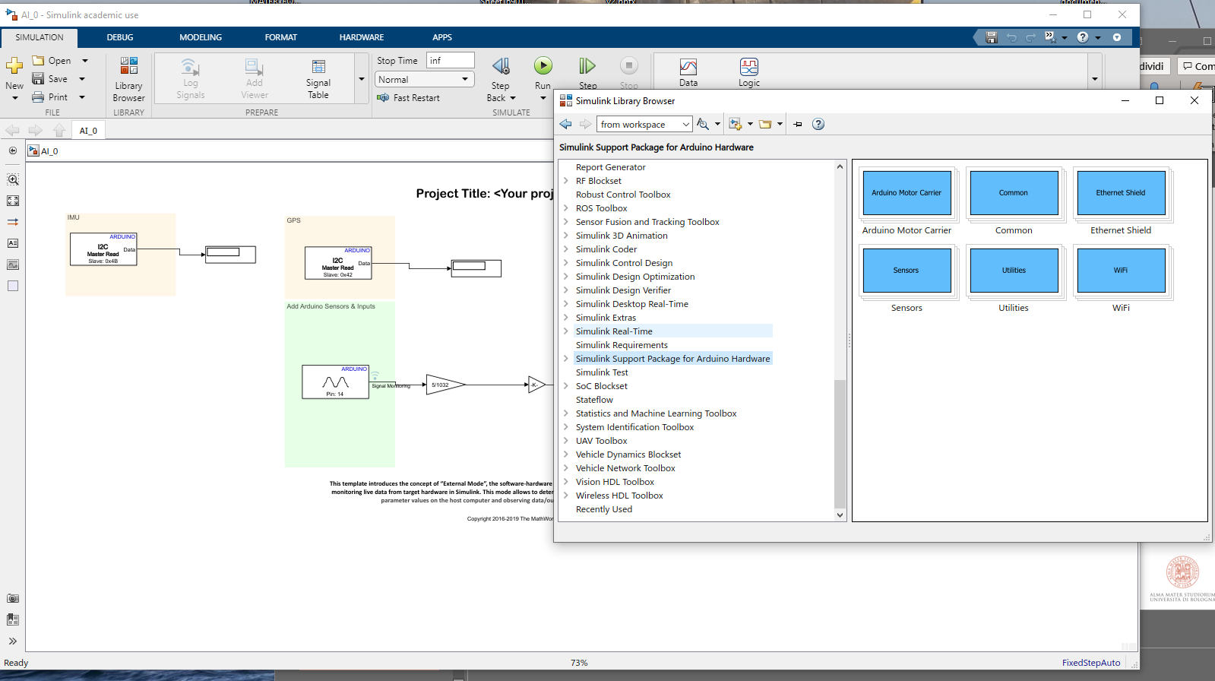
Introduction to Arduino
Arduino & Simulink
Default functions
References: https://www.mathworks.com/hardware-support/arduino-simulink.html

Slide 53
Introduction to Arduino
Arduino & Simulink
EXAMPLES AND DOCUMENTATIONS ON GITHUB
https://duinobasedlearning.github.io/P0_en.html
References: https://www.mathworks.com/hardware-support/arduino-simulink.html

Slide 54
Outline
Arduino
Arduino Programming Language (IDE)
Examples
Arduino & Matlab
Arduino & Simulink
Arduino & Python

Slide 55
Introduction to Arduino
Arduino & Python
Arduino is adding the Python language as an additional option for programming microcontrollers.
The platform is MicroPython
Arduino has developed MicroPython support for most of Arduino boards and the online website will be updated with the latest firmware versions.
A great advantage of using MicroPython is that it is easy to learn and has great documentation for a number of boards. At the moment, there are four boards that can be used together with MicroPython, you can read more about them in the compatible boards section.
Arduino also supports OpenMV's branch of MicroPython, and through the OpenMV IDE you can install MicroPython, connect/disconnect your board and upload your scripts.
It is recommended to have some experience with the Python environment before programming
References: https://docs.arduino.cc/micropython/
https://docs.arduino.cc/retired/other/arduino-and-python/

Slide 56
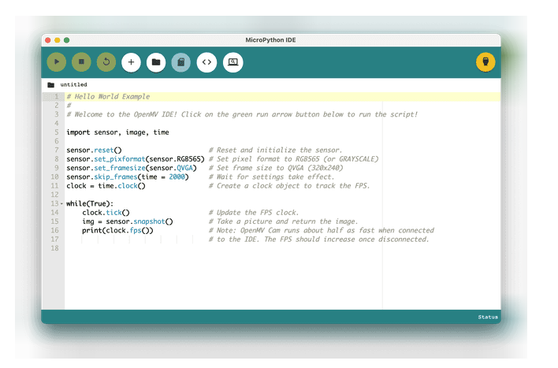
Introduction to Arduino
Arduino & Python
Arduino Lab for MicroPython
The Arduino Lab for MicroPython is a lightweight editor designed for simple interaction between your computer and board. With it, you can select your port, load scripts, and use the REPL shell and more.
EXAMPLES AND DOCUMENTATIONS ON GITHUB
https://docs.micropython.org/en/latest/
References: https://docs.arduino.cc/micropython/
https://labs.arduino.cc/en/labs/micropython

Slide 57
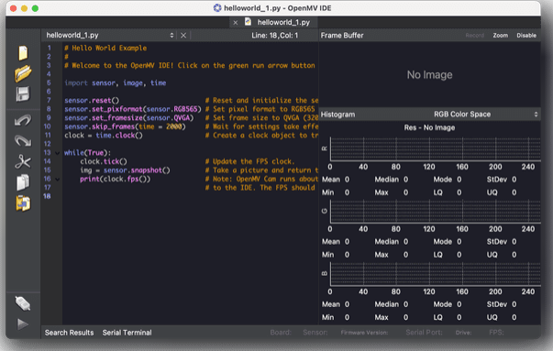
Introduction to Arduino
Arduino & Python
OpenMV Editor
OpenMV is a platform that supports programming Arduino boards using a fork of MicroPython. Through the OpenMV editor, we can install this fork, and upload scripts directly to the board. There's also a number of examples available directly in the editor.
OpenMV is a great platform for computer vision and machine learning projects.
EXAMPLES AND DOCUMENTATIONS ON GITHUB
https://github.com/openmv/openmv/tree/master/scripts/examples/50-Arduino-Boards
References: https://docs.arduino.cc/micropython/
https://labs.arduino.cc/en/labs/micropython

Slide 58
Embedded Systems Introduction
Introduction to Arduino
Department of Industrial Engineering (DIN) – viale del Risorgimento 2, Bologna (BO) Italy
Forlì, 26/09/2024
giacomo.silvagni2@unibo.it

